Slide 2
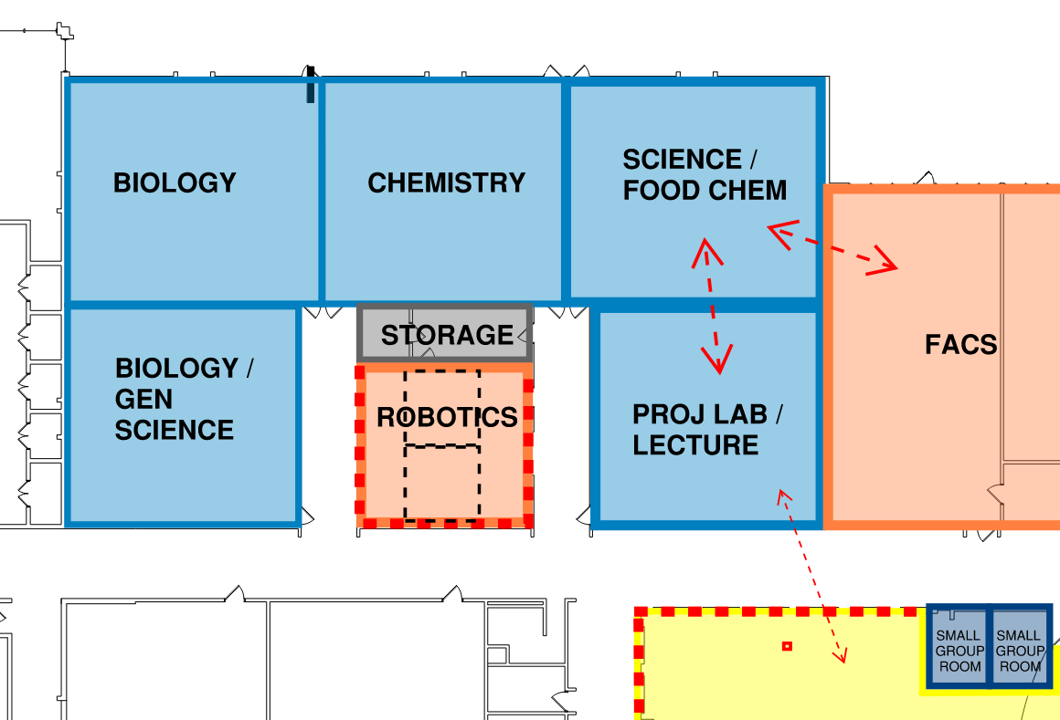
update science suite
STATION 2
Proposed work to include:
New lab stations
Electrical and plumbing updates
New storage and casework
New flexible furniture
Updated finishes
Reconfigure central storage and create Robotics as a featured area
4

Slide 5
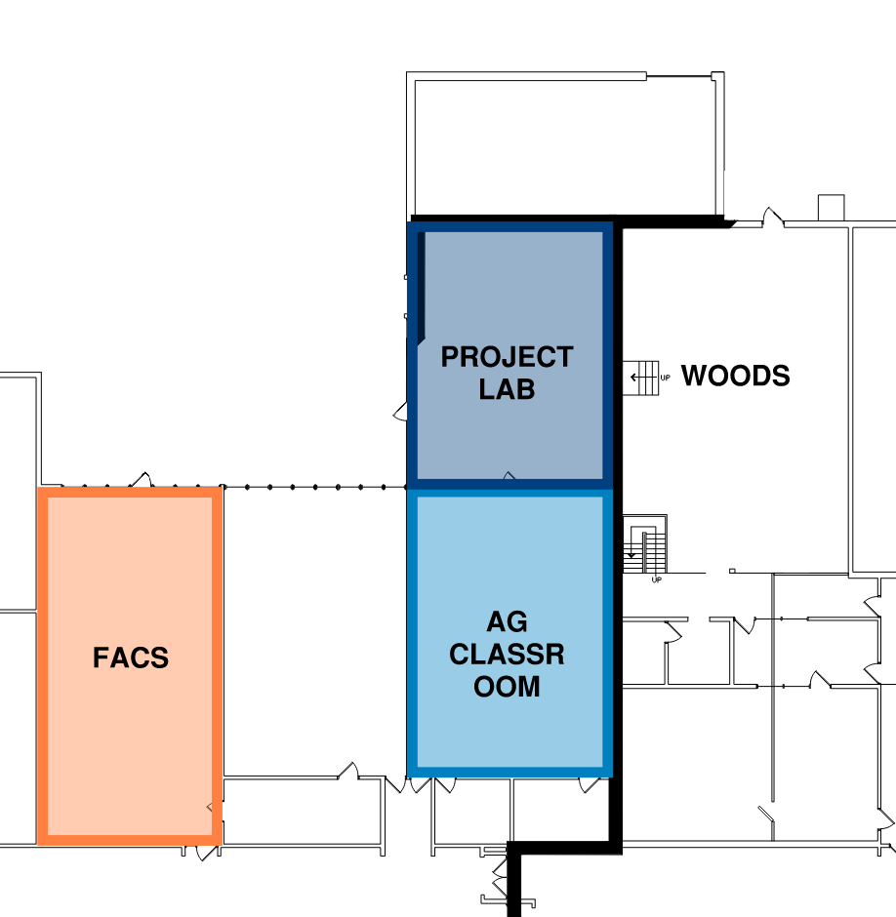
OPTION1: update FACS AND Ag
STATION 3
Renovate FACS and Ag rooms within existing square footage
Renovate to support today’s programming needs
3A

Slide 7
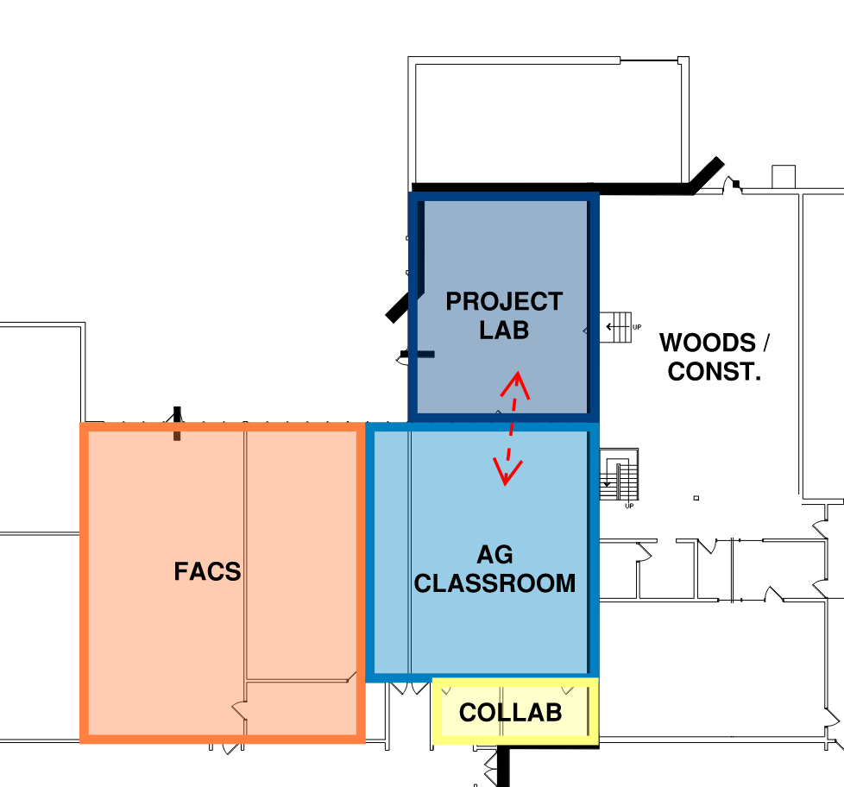
OPTION 2: update AND expand facs AND Ag
STATION 3
Renovated and expanded FACS and Ag rooms
Renovated Ag Project Lab
Reconfiguration allows for new collaborative space along corridor
Requires relocation of Special Education (DCD) room
3B

Slide 8
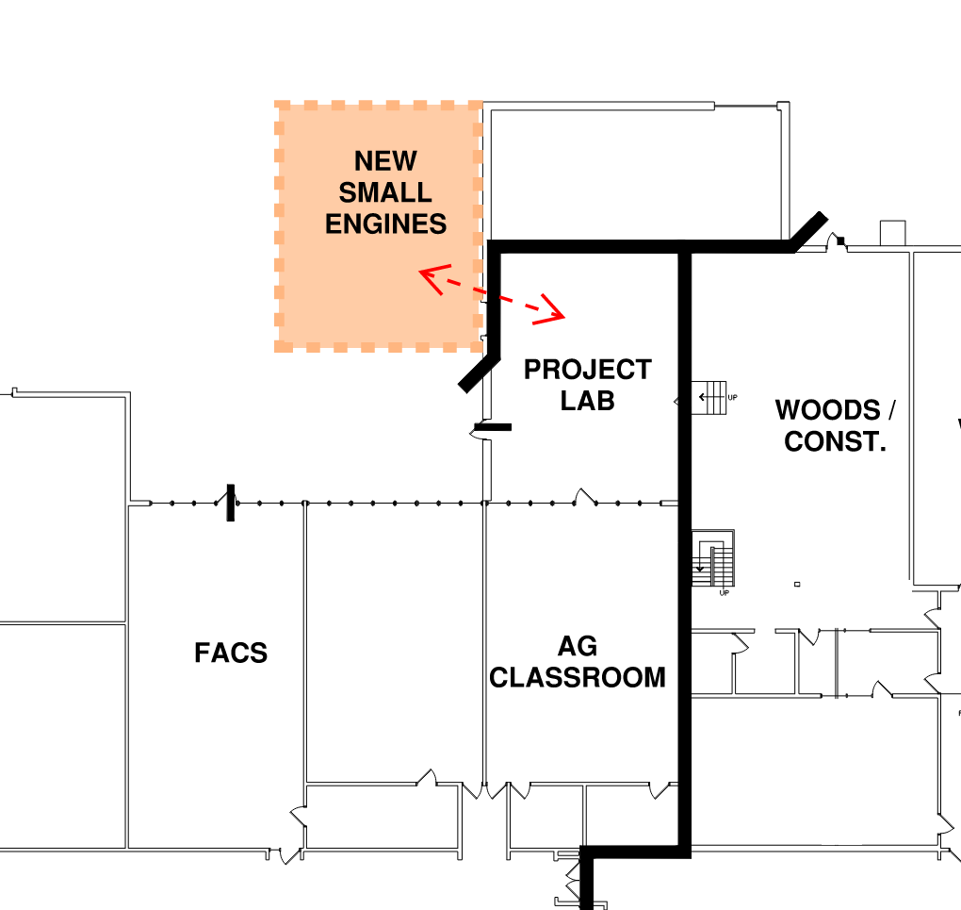
small engines addition
STATION 3
Size of addition does NOT require building to ICC 500 Storm Shelter requirements (building code)
Dedicated Small Engines space with proper ventilation
Direct connection to Ag Project Lab
Selection of this option requires new greenhouse
Any addition requires connection to city water
2

Slide 9
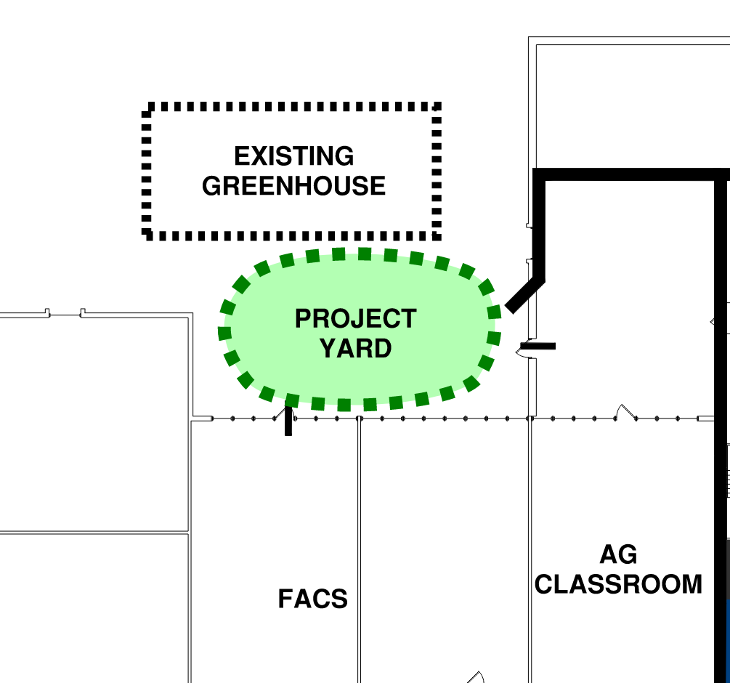
outdoor project yard (Allowance)
STATION 3
New outdoor project yard to support Ag, FACS, and Science programming
12

Slide 10
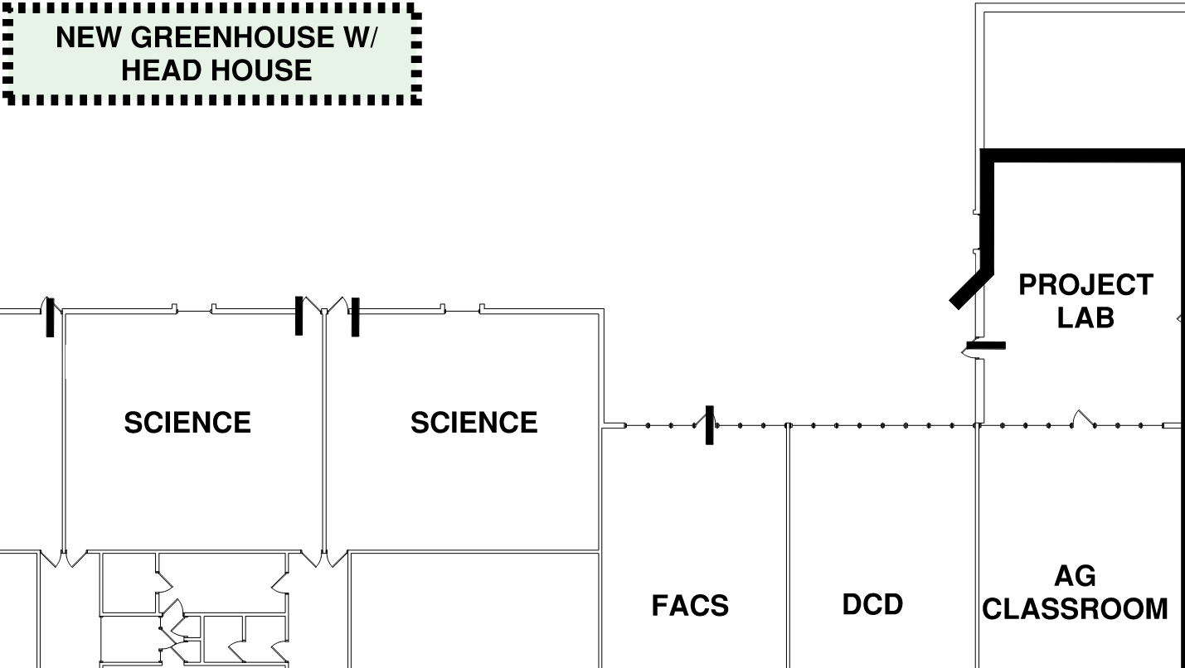
Greenhouse (Allowance)
STATION 3
New Greenhouse with Head House for Material Storage
13

Slide 11
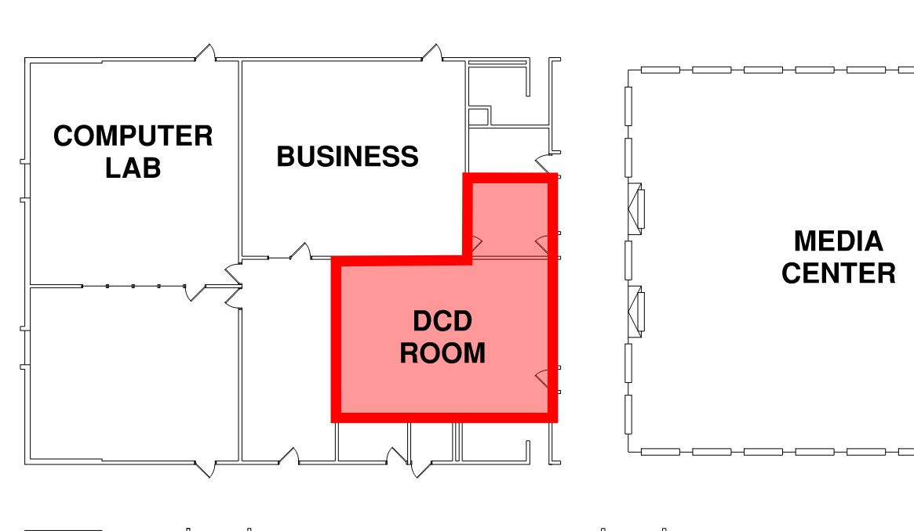
STATION 3
relocate SPECIAL EDUCATION (DCd) room
Remodel existing general classroom to support DCD
Include new accessible restroom
Relocation supports expanded FACS and Ag spaces
11

Slide 12
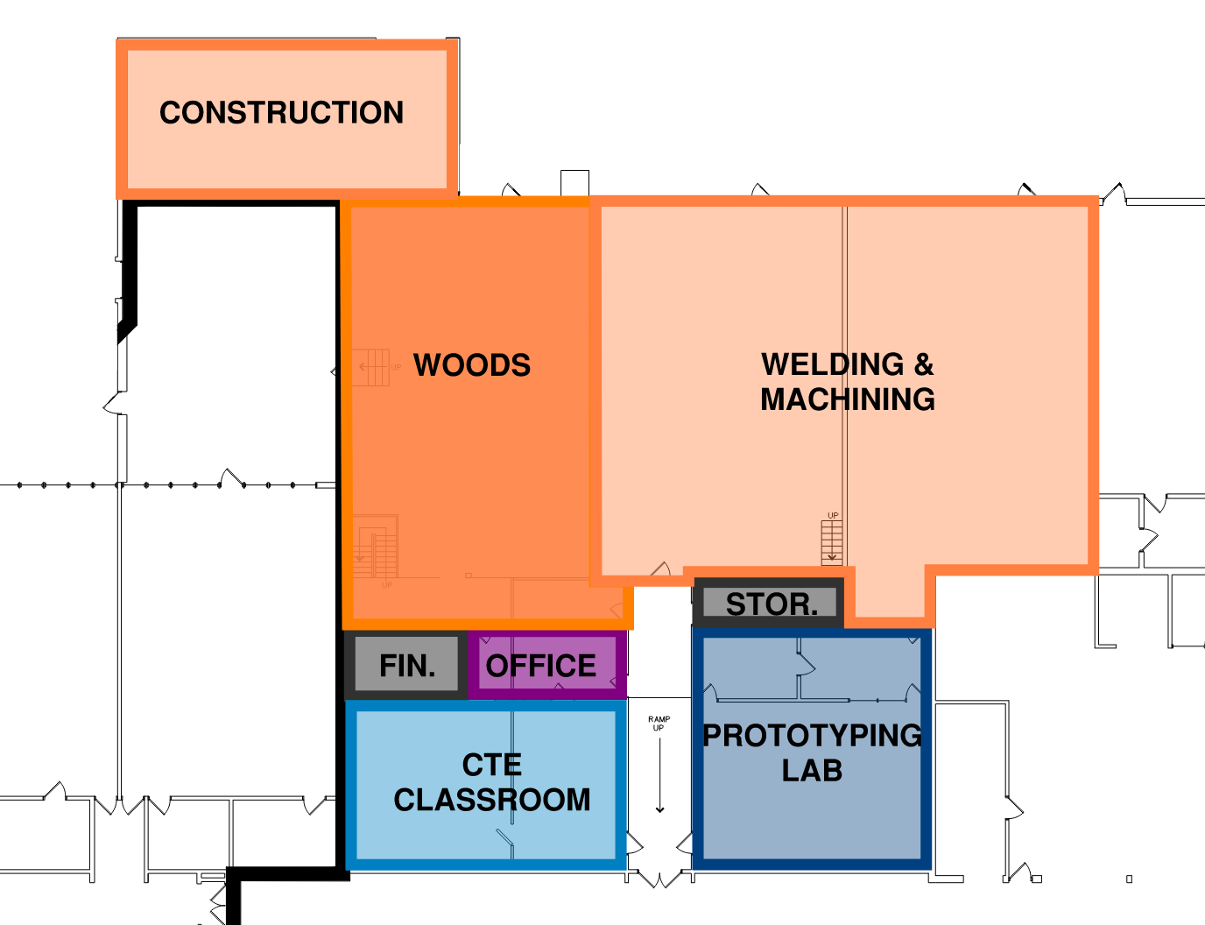
OPTION 1: update cte
STATION 4
Reconfigured CTE spaces within existing square footage
Reimagine CTE classrooms to include Prototyping & Digital Fabrication spaces
No additional square footage
1A

Slide 14
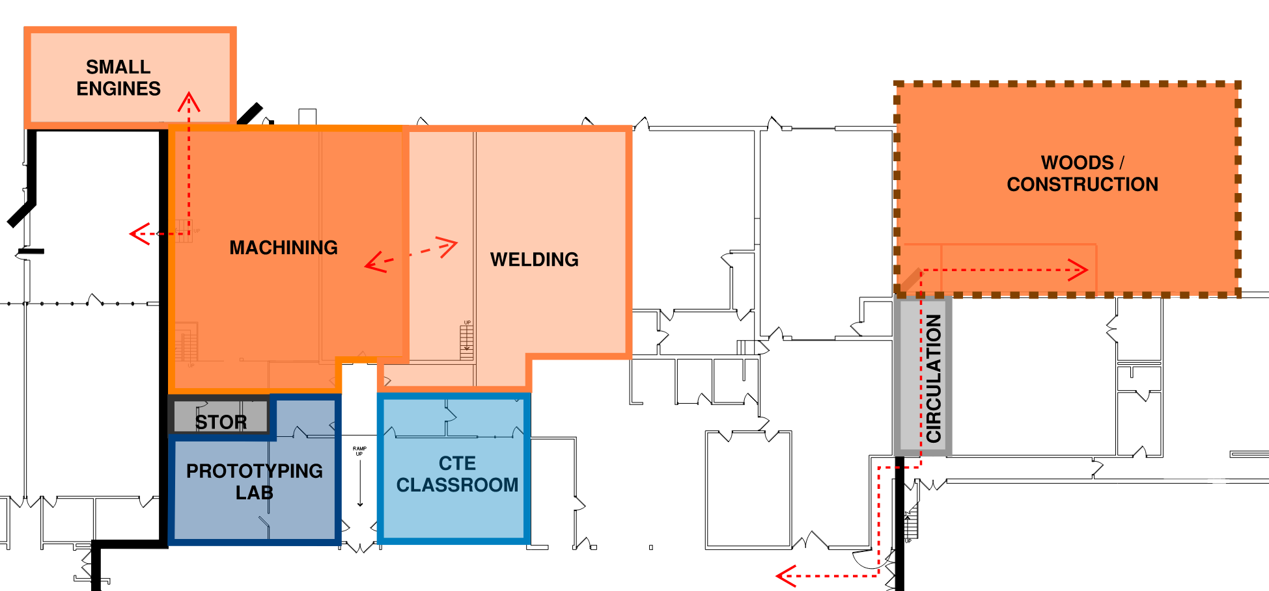
OPTION 2: cte shop reconfiguration & addition
STATION 4
Size of addition requires new Woods and Construction Lab to be built to ICC 500 Storm Shelter requirements (building code)
All shop spaces increase in size
Loss of connection and adjacency between shop spaces
Any addition requires connection to city water
1B

Slide 15
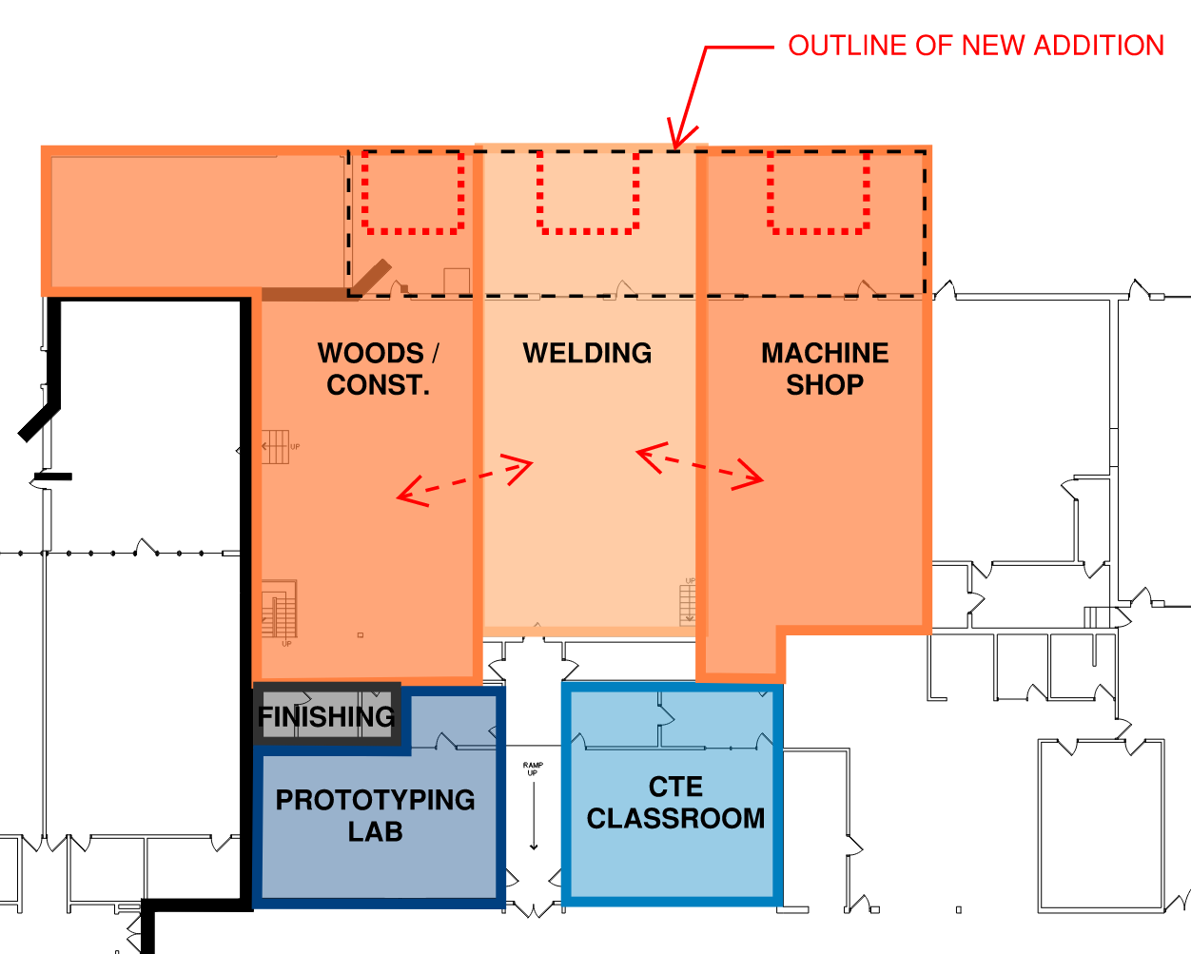
OPTION 3: cte expansion
STATION 4
Size of addition does NOT require building to ICC 500 Storm Shelter requirements (building code)
All shop spaces increase in size
Connection and adjacency between shops is retained
Reimagined classroom spaces to support prototyping and digital fabrication
Supports multi-discipline fabrication
Any addition requires connection to city water
1C

Slide 17
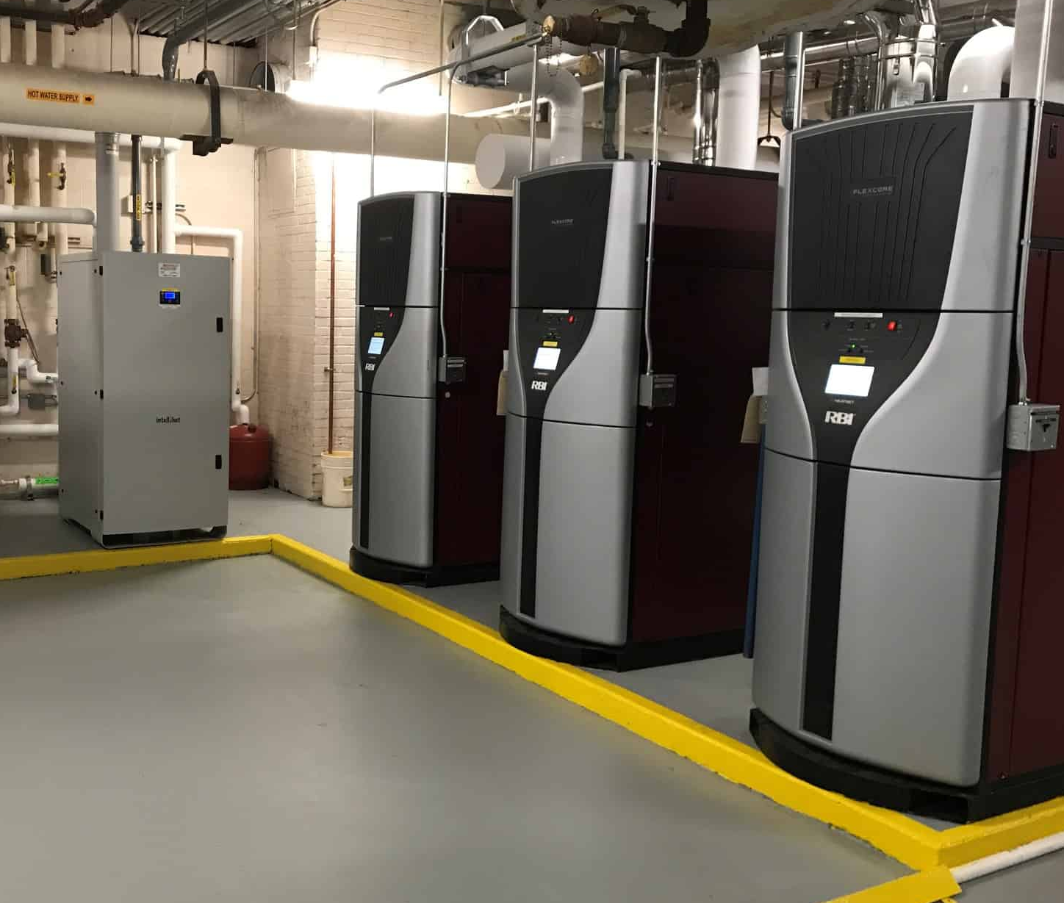
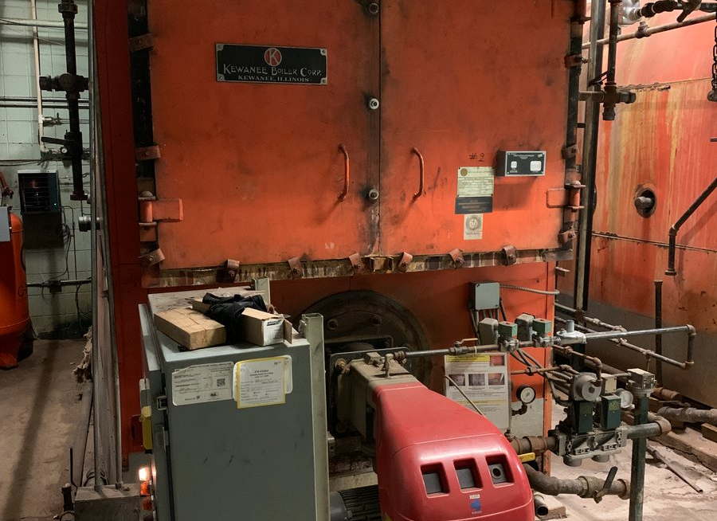
boiler room and mechanics
STATION 5
Example of new boiler plant
Steam Heating
Steam piping is original to the building
(2) Original Kewanee steam boiler 52 years old; 22 years past their expected useful life
Difficult to control and creates temperature issues
High maintenance and operational costs
Pneumatic Controls
Pneumatic actuators and thermostats are original to the building construction
Pneumatics need to be recalibrated or replaced frequently for proper operation
Antiquated technology with limited function and control
Current boiler
M.1

Slide 18
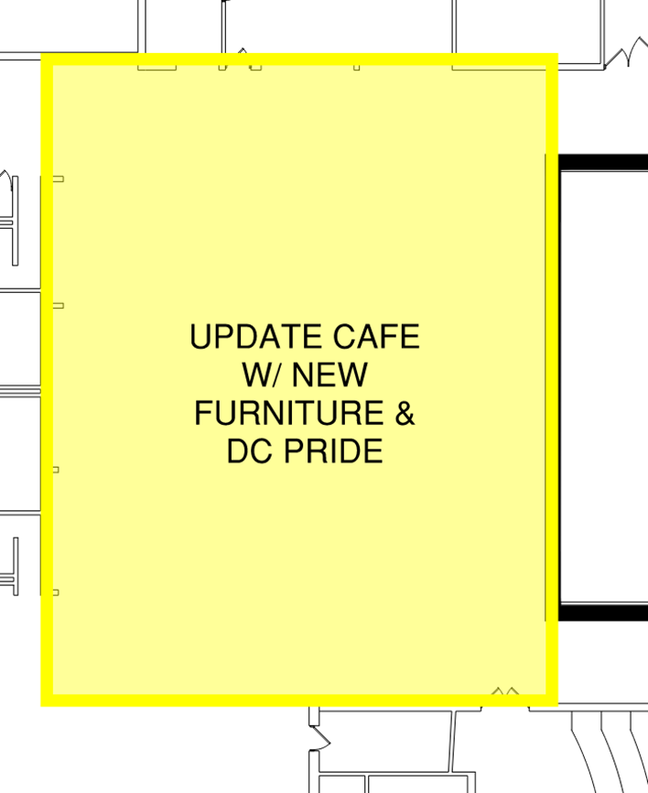
update HS COMMONS and restrooms
STATION 6
Update serving space with modern feel and improve flow
Update furniture to provide students variety and expand commons use beyond mealtimes
Display of Charger pride with finishes, acoustic products, displays, wall graphics, etc.
Reconfigure and update restrooms near high school cafeteria/commons
7
14

Slide 19
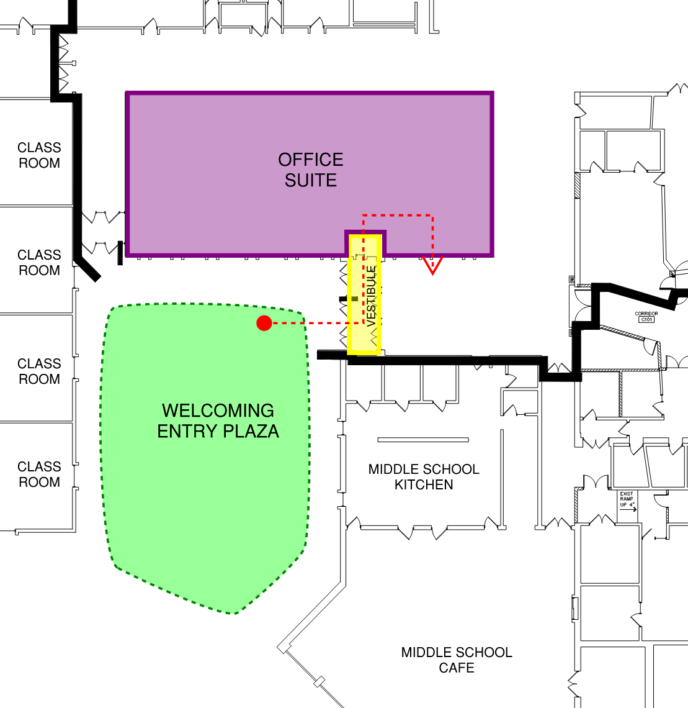
OPTION 1: reconfigure HS office and entryway
STATION 6
Reconfigure existing high school office and vestibule to create safe and secure entryway
Create a welcoming outdoor entry plaza with landscaping, signage and gathering areas
5A

Slide 20
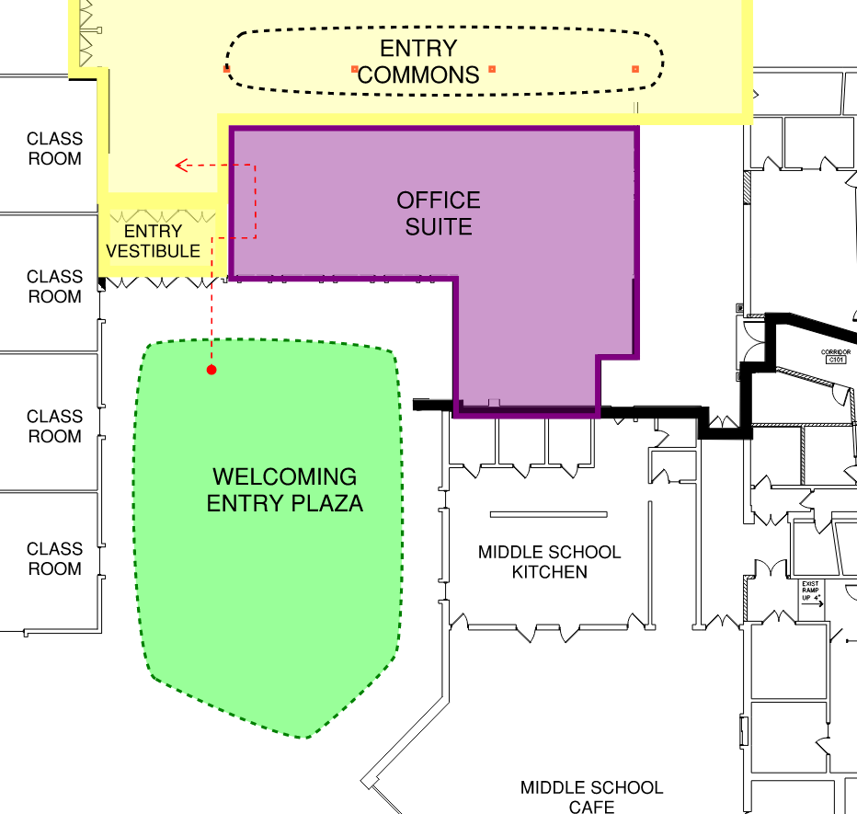
OPTION 2: reconfigure HS office and entryway
STATION 6
Create safe and secure entry
Work largely within existing footprint, small reconfiguration and addition to entry vestibule
Create a welcoming outdoor entry plaza with landscaping, signage and gathering areas
Includes small entry commons space
Reconfigure office and entry sequence to maximize square footage
Requires new egress door from MS Cafeteria
Any addition requires connection to city water
5B

Slide 21
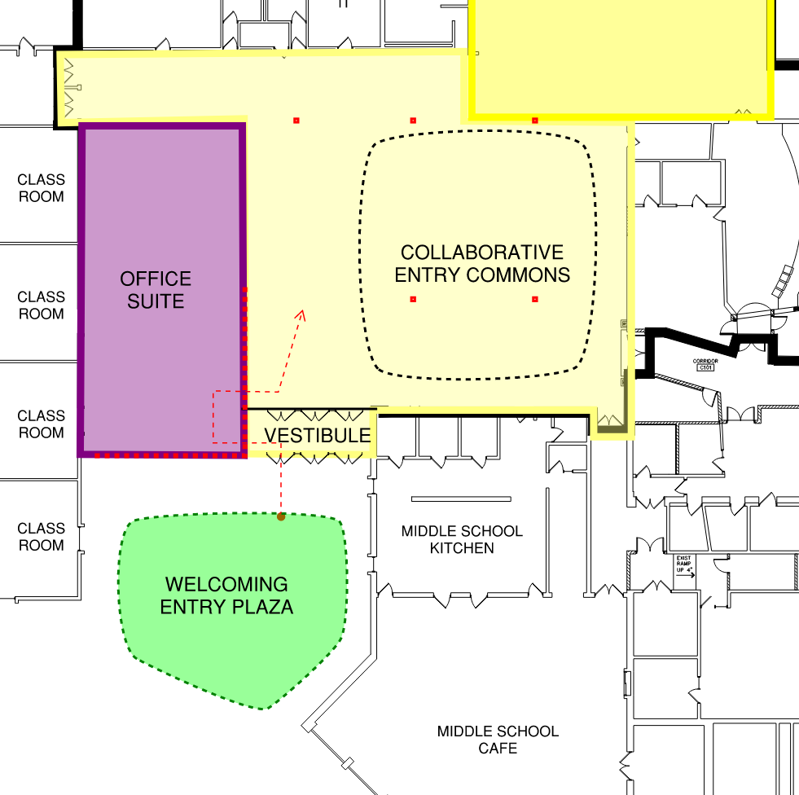
OPTION 3: NEW ENTRYWAY, HS OFFICE, AND commons
STATION 6
New addition to create a presence for the front of the school.
Addition to include HS office, secure entryway, and entry commons
Create a welcoming outdoor entry plaza with landscaping, signage and gathering areas
Any addition requires connection to city water
5C

Slide 24
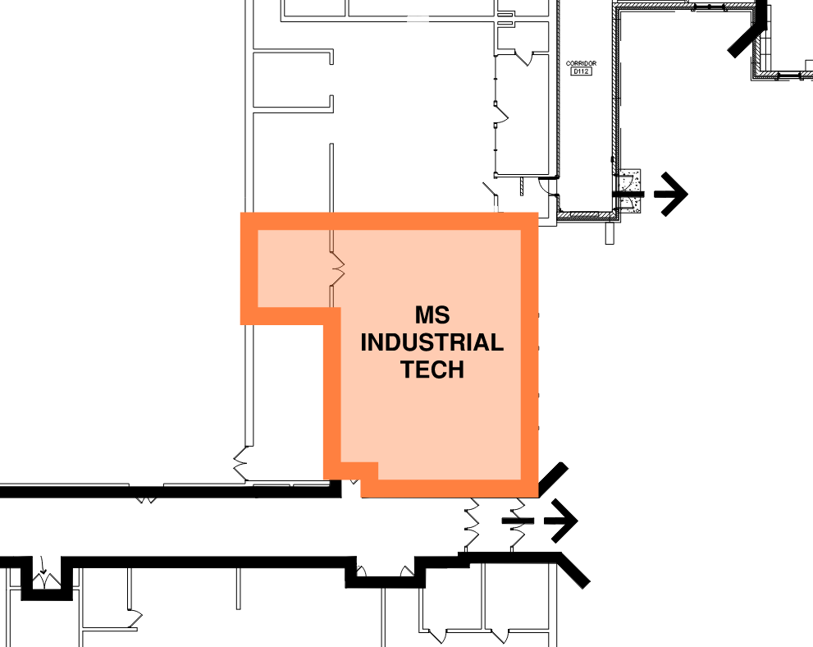
OPTION 1: Renovate MS Industrial Tech
STATION 7
Renovate to support current and future-ready programming
8

Slide 25
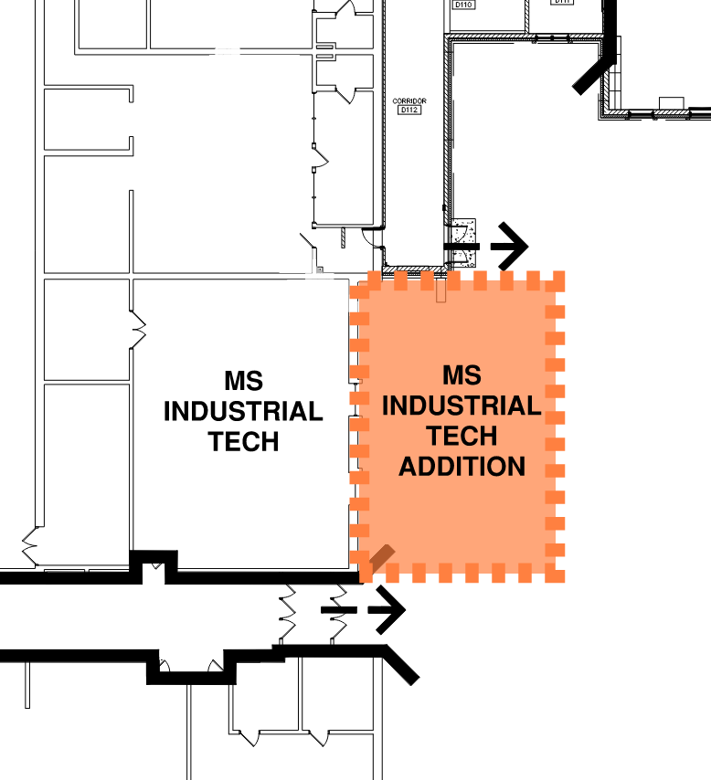
OPTION 2: MS Industrial Tech addition
STATION 7
Size of addition does NOT require building to ICC 500 Storm Shelter requirements (building code)
Addition allows for separate clean and messy project spaces
Enlarged space allows for expanded exploration and feeder programming for high school Career and Technical Education (CTE)
Addition requires fire suppression system to be added to the entire MS
Any addition requires connection to city water
9

Slide 26
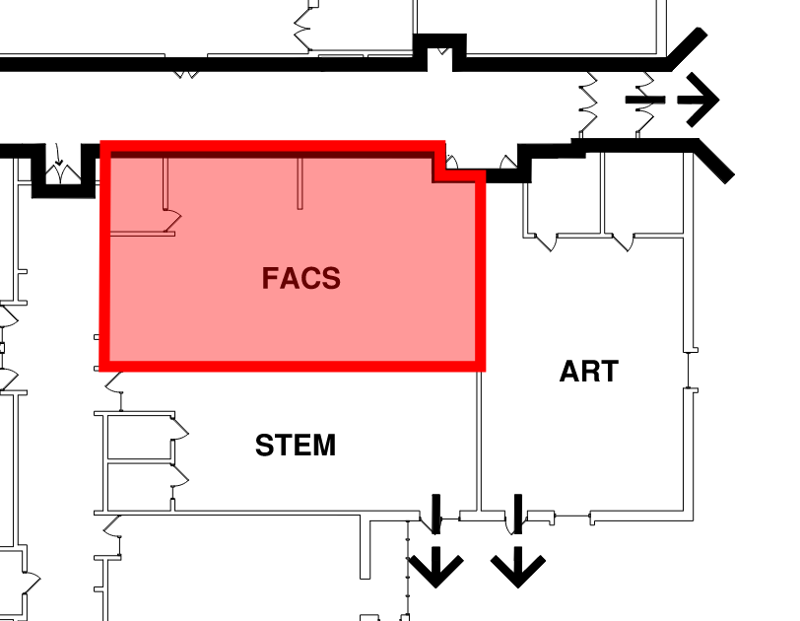
OPTION 1: Update ms FACS
STATION 7
Update existing square footage to support current programming needs
Updates to include finishes and furniture
Existing kitchen labs to remain
10A

Slide 27
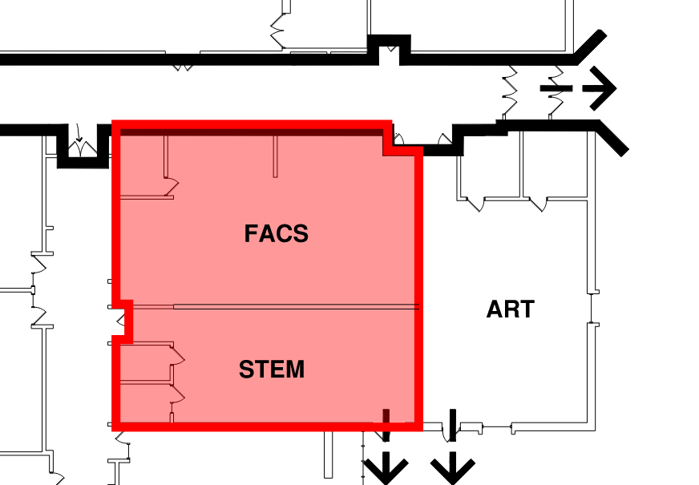
OPTION 2: expand ms facs
STATION 7
Relocate STEM in order to increase FACS room to original dimension
Increased size supports additional FACS programming and projects
Updates to include finishes and furniture; existing kitchens to remain
Includes updating flooring and storage solutions in STEM classroom
10B

Slide 31
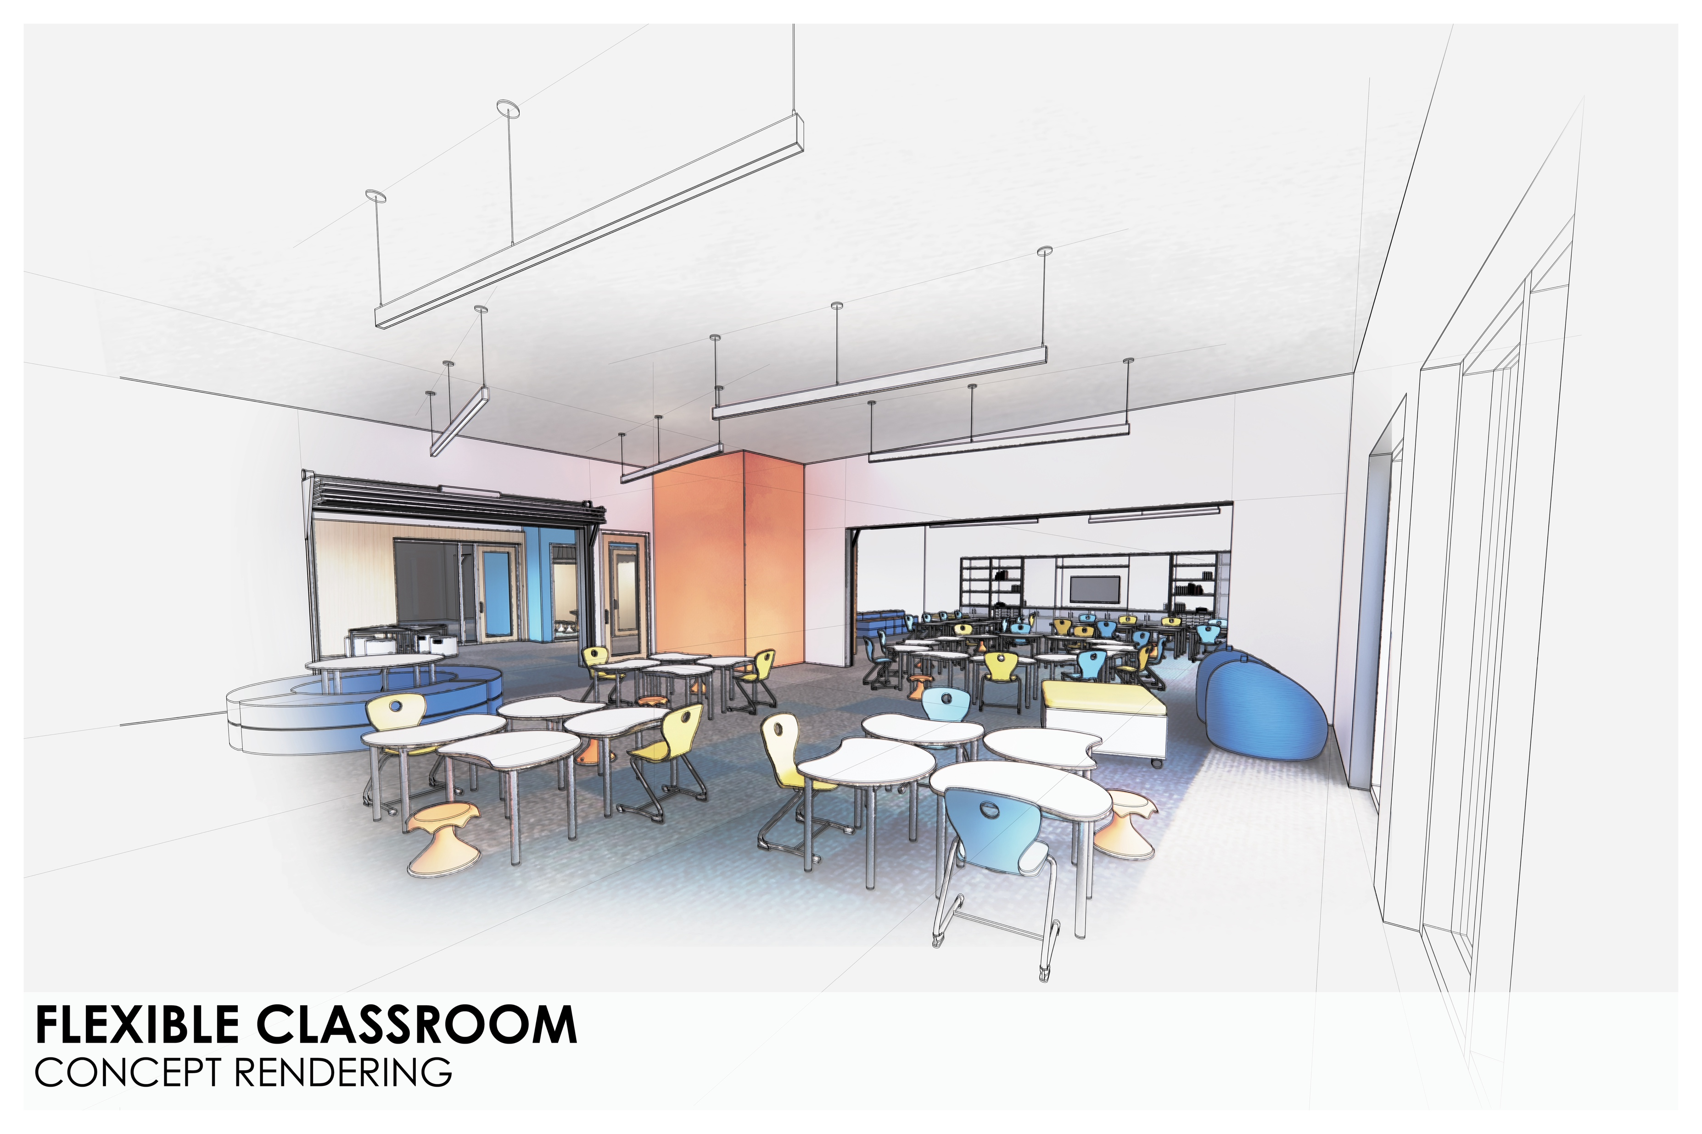

Slide 32
